Slide 1


Smart LPG Leakage Detector
To ensure ultimate safety.

Slide 2

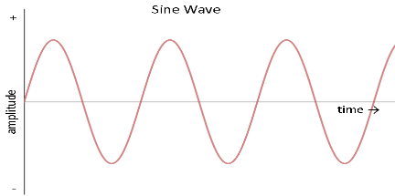
Problem :
Places like hotels, restaurants, kitchens, canteens, and some industries or factories which depend or use LPG, might put that place in risk of causing the fire accidents.
Exploding cooking gas cylinders and stoves accounted for fire accidents between 2010 and 2014, with a total of 19,491 deaths.
As every where AC supply is used, due to change in current, a small spark while gas is leaking, can lead to a huge fire explosion

Slide 3
Solution :
Turning of the main supply, when there is a gas leakage can avoid the fire accidents.
Alerting the user and to fire station about the gas leakage and sharing the location of it would help to take necessary action, because there is no second chance.
Alerting the near by people through an alarm, can save life's.

Slide 4
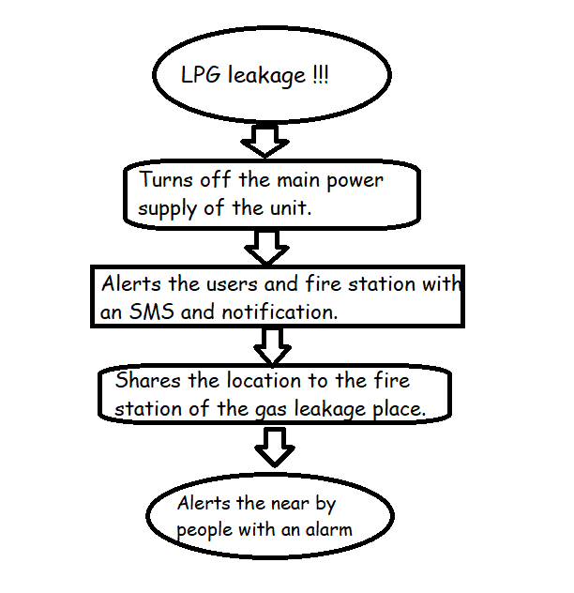
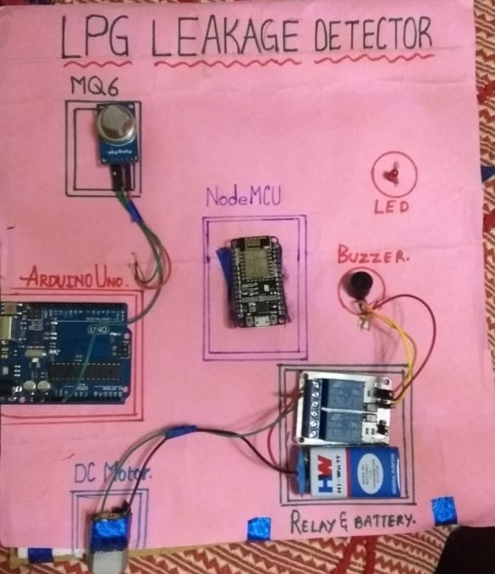
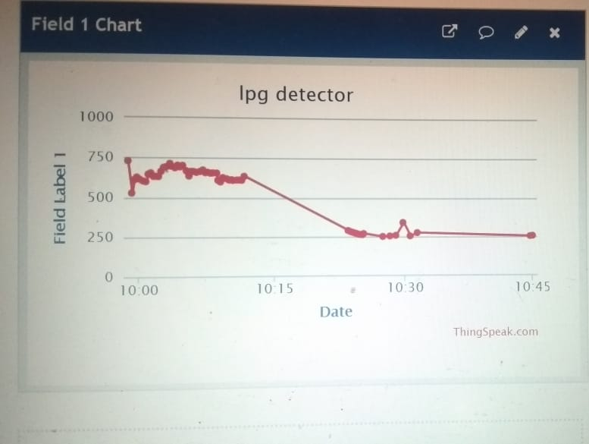

Slide 5
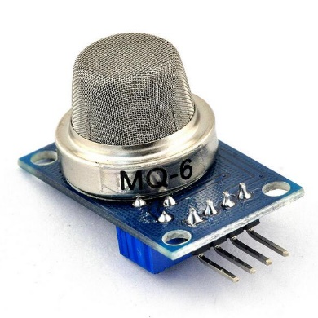
Components :
MQ6 :
High sensitivity to LPG, iso-butane, propane
Small sensitivity to alcohol, smoke.
Fast response .
Stable and long life
Simple drive circuit

Slide 6
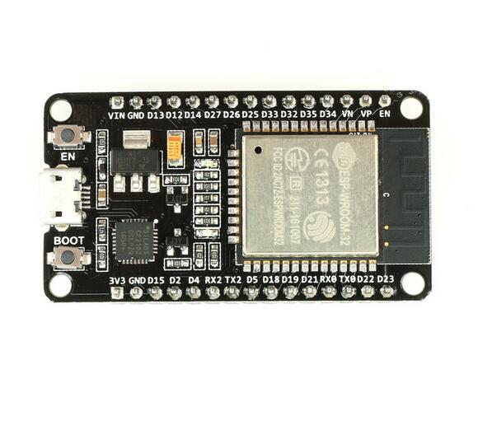
NodeMCU :
An open-source firmware and development kit that helps you to connect your application to internet and for monitoring and control.
Open-source
Interactive
Programmable,
Low cost,
Simple, Smart, WI-FI enabled

Slide 7
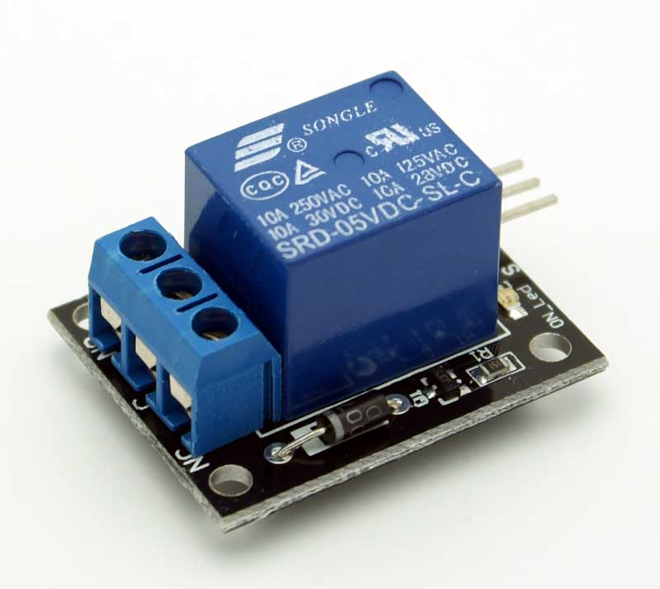
Relay :
Electrically operated electromagnet to mechanical switch.
Low cost
Easy to operate through computation.

Slide 8
Requirements :
Wi-Fi connection connected to separate DC supply.
NodeMCU – Rs. 300*
MQ6 sensor – Rs. 170*
Relay – Rs. 150*

Slide 9
THANK YOU!

